Slide 2
MBAS841 Operations Management Analyzing Process Data
Master of Management Analytics– Session 4
Geoff Pond
Notes:
An example of a title page with more specific program details in the title

Slide 3
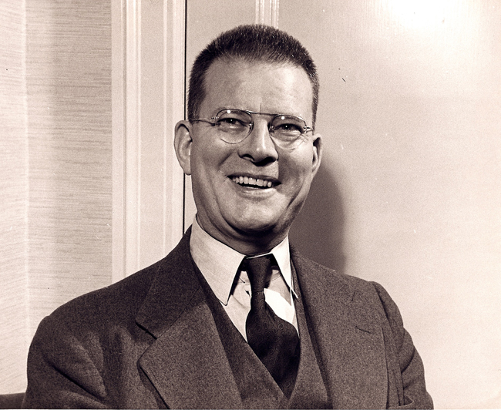
Process Analysis from a Managerial Perspective
We should work on our process, not the outcome of our processes.
The role of management is to change the process rather than badgering individuals to do better.

Slide 4
Agenda
At the process design stage,
Is the process capable of meeting consumer specifications with reasonable consistency?
Following implementation,
Is the process behaving the way we expect it to?
Today, our focus will be on the collection and analysis of data to objectively answer each of the above questions.

Slide 5
Process Capability Analysis

Slide 6
Is my process “capable”?
For a process having normally distributed natural variability (many in manufacturing and production), the distribution generally appears as illustrated at left.
Recalling the empirical rule, 99.7% of a normally distributed RV falls within three standard deviations of the mean.
If 99.7% (or more) of output falls within customer specifications, the process is deemed “capable”. Tighter specifications are also very common.

Slide 7
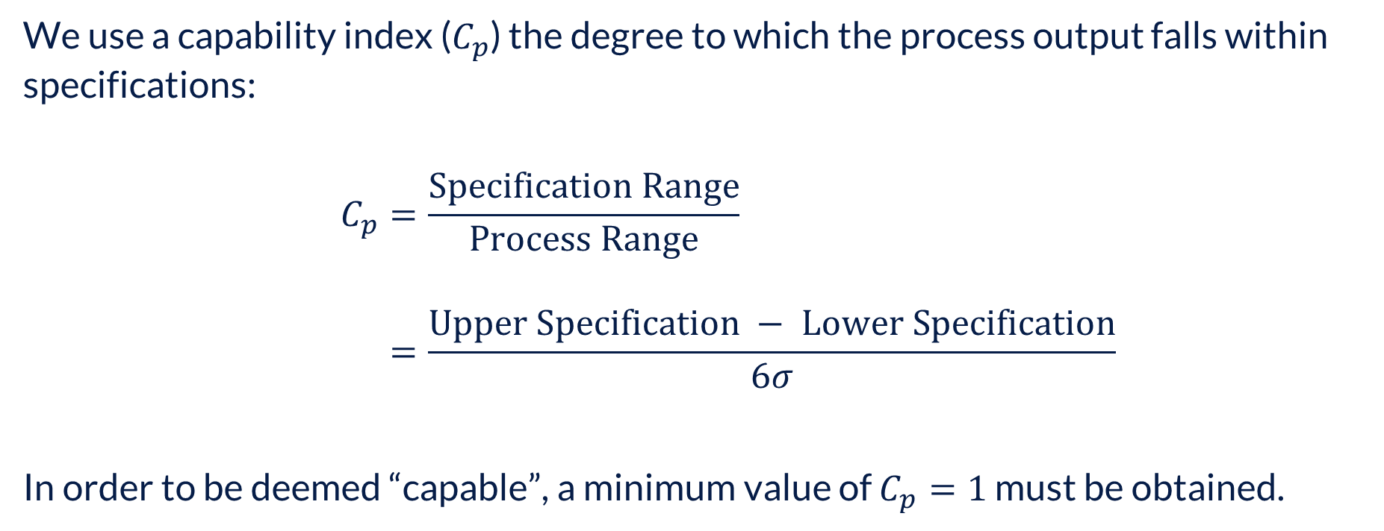
Is my process capable?
We use a capability index ($C_{p}$) the degree to which the process output falls within specifications:
$$C_{p}=\frac{Specification Range}{Process Range} \\ =\frac{Upper Specification − Lower Specification}{6σ}$$
In order to be deemed “capable”, a minimum value of $C_{p}=1$ must be obtained.

Slide 8
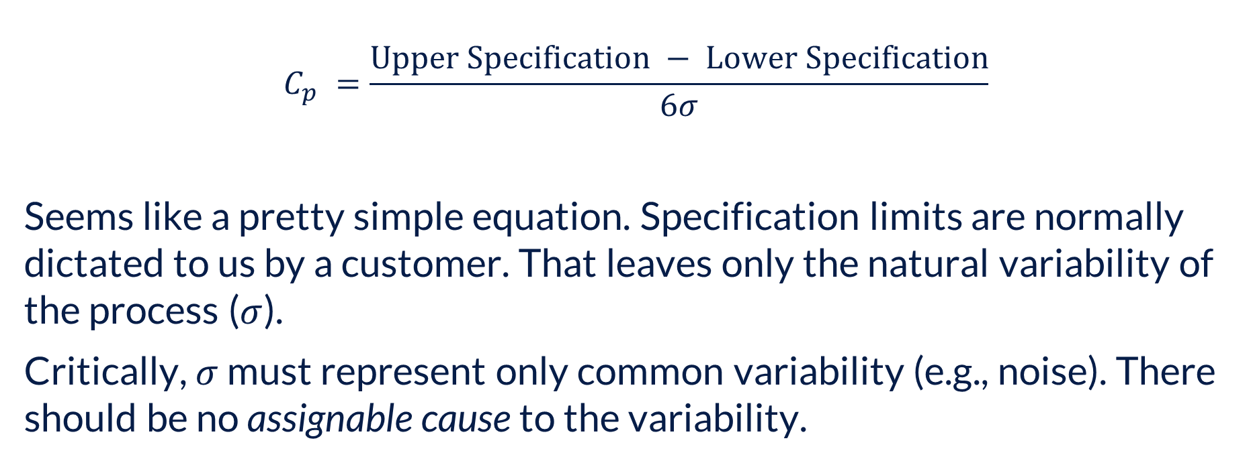
Process Capability Analysis
$$C_{p} =\frac{Upper Specification − Lower Specification}{6σ}$$
Seems like a pretty simple equation. Specification limits are normally dictated to us by a customer. That leaves only the natural variability of the process ($σ$).
Critically, $σ$ must represent only common variability (e.g., noise). There should be no assignable cause to the variability.

Slide 9
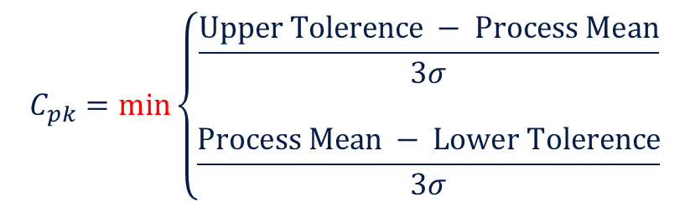
Process Capability Analysis
How do I handle product specifications that are not symmetric, e.g.,
+0.010
Ø2.000
-0.005
$$C_{pk}=min\left\{\begin{matrix}\frac{Upper Tolerence − Process Mean}{3σ} \\ \\ \frac{Process Mean − Lower Tolerence}{3σ}\end{matrix}\right.$$

Slide 10
Six-Sigma Process Control

Slide 11
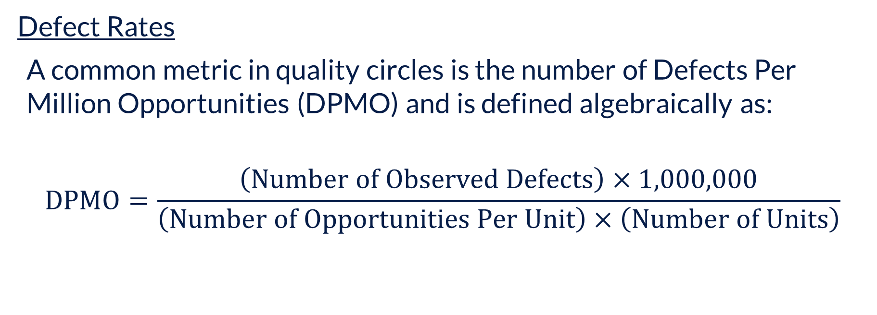
Process Control
Defect Rates
A common metric in quality circles is the number of Defects Per Million Opportunities (DPMO) and is defined algebraically as:
$$\text{DPMO}=\frac{\left(\text{Number} \text{of} \text{Observed} \text{Defects}\right)×1,000,000}{\left(\text{Number} \text{of} \text{Opportunities} \text{Per} \text{Unit}\right)×\left(\text{Number} \text{of} \text{Units}\right)}$$

Slide 12
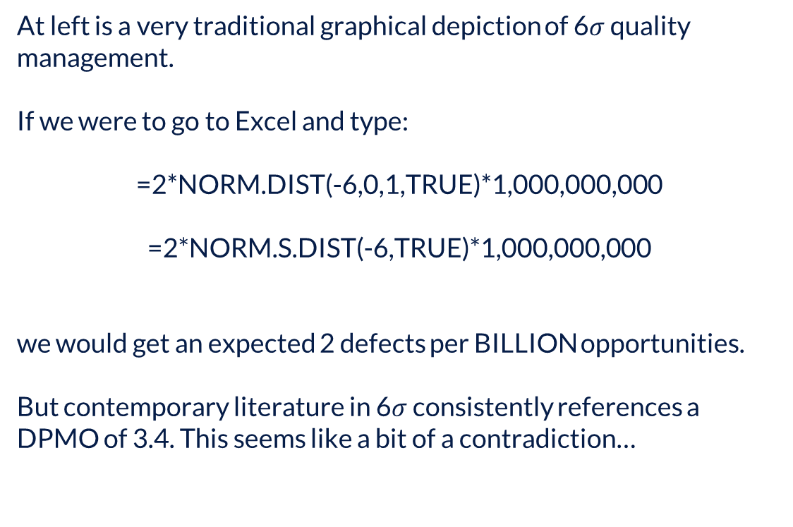
Process Control
At left is a very traditional graphical depiction of 6$σ$ quality management.
If we were to go to Excel and type:
=2*NORM.DIST(-6,0,1,TRUE)*1,000,000,000
=2*NORM.S.DIST(-6,TRUE)*1,000,000,000
we would get an expected 2 defects per BILLION opportunities.
But contemporary literature in 6$σ$ consistently references a DPMO of 3.4. This seems like a bit of a contradiction…
UTL

Slide 13
Process Control
Process capability studies are largely founded in the work done by Motorola in the 1980s and 1990s. Motorola found that processes naturally drift over time. They may drift in one direction naturally and as time continues, start to drift back – without any intervention whatsoever.
Motorola termed this the “Long Term Dynamic Mean Variation” and found that, numerically, it resulted in a shift of 1.4 to 1.6 standard deviations from the process centre.
This has since become known as the “1.5 sigma shift”.
UTL

Slide 14
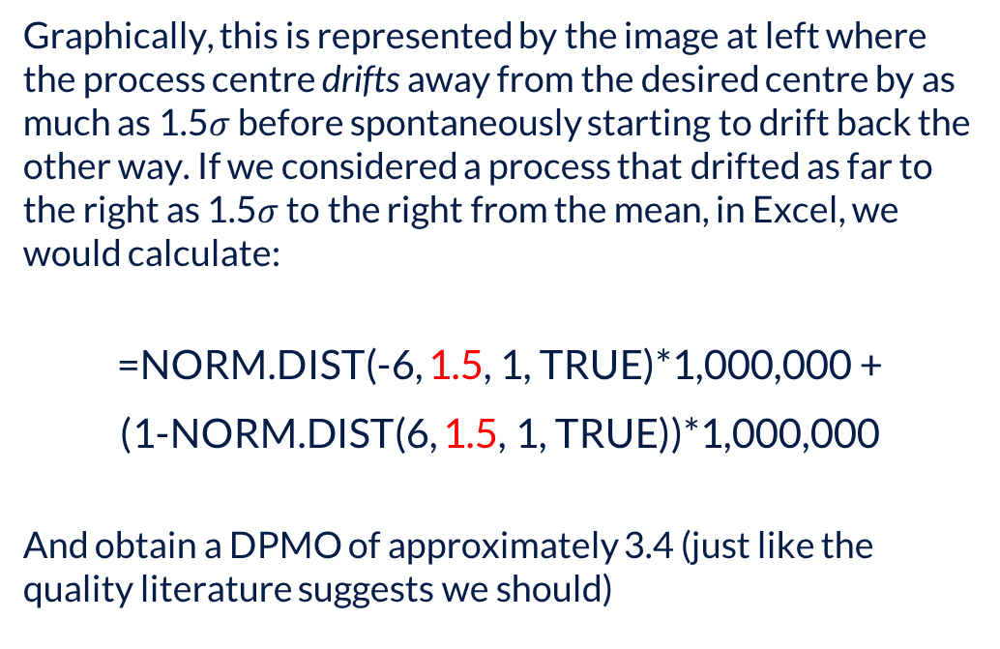
Process Control
Graphically, this is represented by the image at left where the process centre drifts away from the desired centre by as much as 1.5$σ$ before spontaneously starting to drift back the other way. If we considered a process that drifted as far to the right as 1.5$σ$ to the right from the mean, in Excel, we would calculate:
=NORM.DIST(-6, 1.5, 1, TRUE)*1,000,000 +
(1-NORM.DIST(6, 1.5, 1, TRUE))*1,000,000
And obtain a DPMO of approximately 3.4 (just like the quality literature suggests we should)
UTL

Slide 15
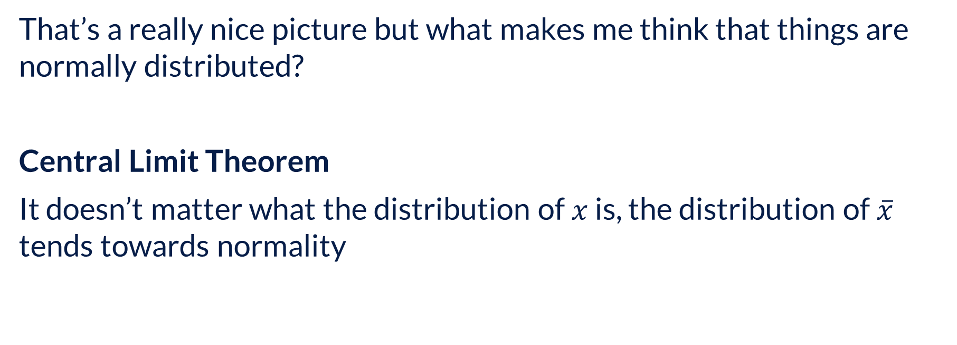
Process Control
That’s a really nice picture but what makes me think that things are normally distributed?
Central Limit Theorem
It doesn’t matter what the distribution of $x$ is, the distribution of $\overline{x}$ tends towards normality

Slide 16

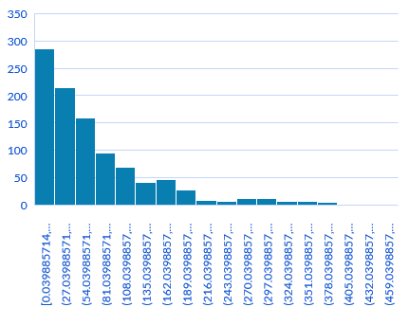
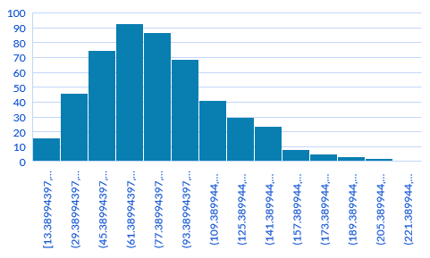
Process Control
Consider an exponential distribution with a mean of 80. In Excel, I generated 1,000 random numbers from such a distribution to obtain the following histogram:
Then I generated 500 random samples of 5 observations from the distribution at left. For each sample, I find the average. Then I obtained a histogram of those averages. It is approaching a normal distribution.

Slide 17
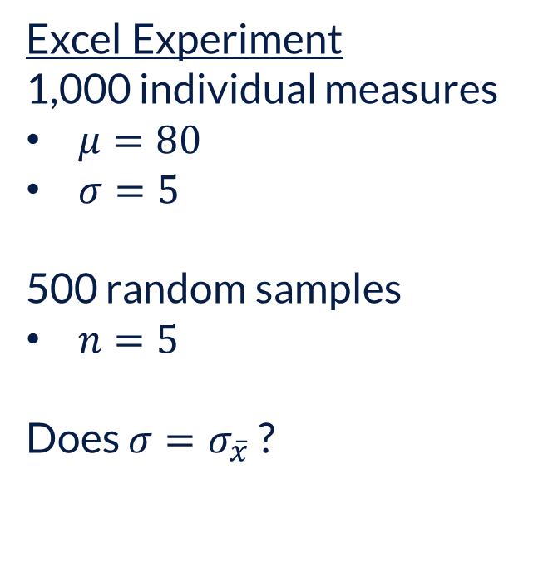
Process Control
Excel Experiment
1,000 individual measures
$μ=80$
$σ=5$
500 random samples
$n=5$
Does $σ=σ_{\overline{x}}$?

Slide 18
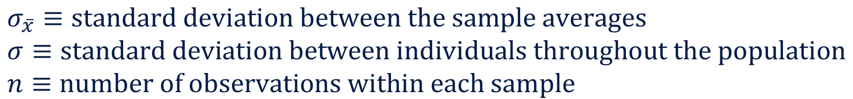

Process Control
No! But a relationship exists between the two:
$$σ_{\overline{x}}=\frac{σ}{\sqrt{n}}$$
$$σ_{\overline{x}}≡\text{standard} \text{deviation} \text{between} \text{the} \text{sample} \text{averages} \\ σ≡\text{standard} \text{deviation} \text{between} \text{individuals} \text{throughout} \text{the} \text{population} \\ n≡\text{number} \text{of} \text{observations} \text{within} \text{each} \text{sample}$$

Slide 19

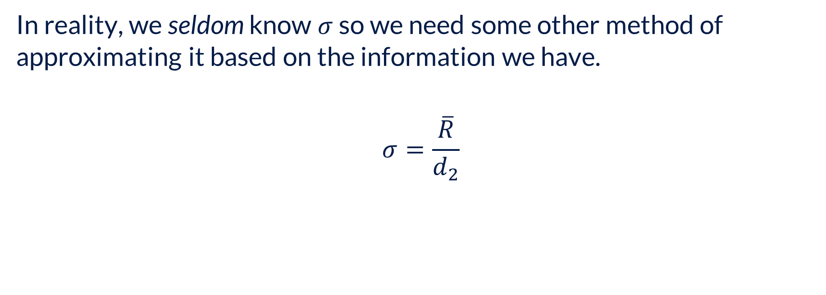
Process Control – Approximating $σ$
In reality, we seldom know $σ$ so we need some other method of approximating it based on the information we have.
$$σ=\frac{\overline{R}}{d_{2}}$$

Slide 20
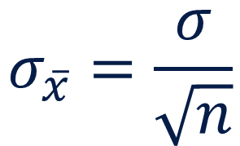
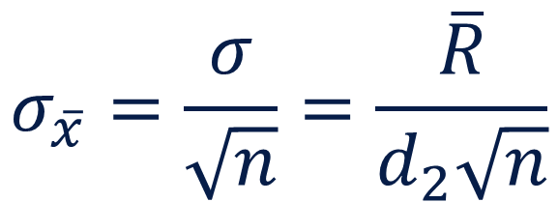
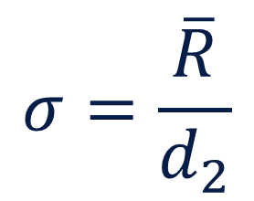
Process Control – Approximating $σ$
Finally, combining our two previous equations,
$$σ=\frac{\overline{R}}{d_{2}}$$
$$σ_{\overline{x}}=\frac{σ}{\sqrt{n}}$$
$$σ_{\overline{x}}=\frac{σ}{\sqrt{n}}=\frac{\overline{R}}{d_{2}\sqrt{n}}$$

Slide 21


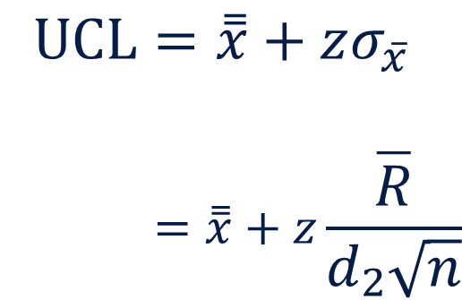
Process Control – Shehwart’s $\overline{x}$-chart
Assuming normal variability, typical practice is to set control limits to be within 3 standard deviations of the mean, so $z=3$.
$$\text{UCL}=\overset{̿}{x}+zσ_{\overline{x}} \\ =\overset{̿}{x}+z\frac{\overline{R}}{d_{2}\sqrt{n}}$$

Slide 22
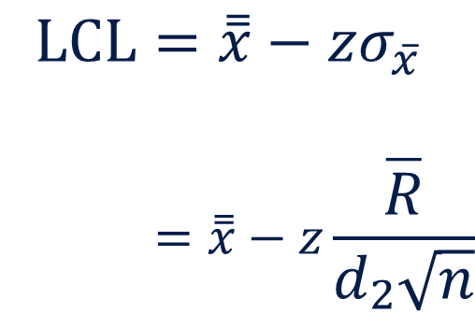
Process Control – Shehwart’s $\overline{x}$-chart
Assuming normal variability, typical practice is to set control limits to be within 3 standard deviations of the mean, so $z=3$.
$$\text{L}\text{CL}=\overset{̿}{x}−zσ_{\overline{x}} \\ =\overset{̿}{x}−z\frac{\overline{R}}{d_{2}\sqrt{n}}$$

Slide 23


Process Control – Shewhart’s $R$-chart
When we use only sample averages, we lose information related to the variability within a sample. Instead, we’re considering only the variability between samples. Recognizing this, Shewhart also introduced recommended limits on the sample range ($R$):
$$UCL=D_{4}\overline{R}$$
$$LCL=D_{3}\overline{R}$$

Slide 24
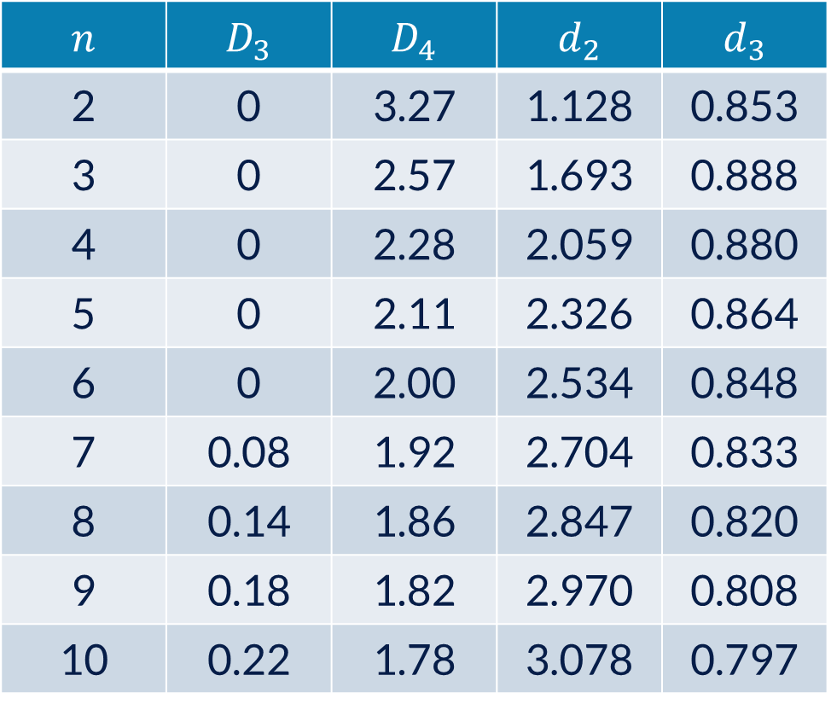
Process Control - Control Chart Constants
$$n$$ | $$D_{3}$$ | $$D_{4}$$ | $$d_{2}$$ | $$d_{3}$$
2 | 0 | 3.27 | 1.128 | 0.853
3 | 0 | 2.57 | 1.693 | 0.888
4 | 0 | 2.28 | 2.059 | 0.880
5 | 0 | 2.11 | 2.326 | 0.864
6 | 0 | 2.00 | 2.534 | 0.848
7 | 0.08 | 1.92 | 2.704 | 0.833
8 | 0.14 | 1.86 | 2.847 | 0.820
9 | 0.18 | 1.82 | 2.970 | 0.808
10 | 0.22 | 1.78 | 3.078 | 0.797

Slide 25
Process Control – Control Charts
UCL
Sheet Thickness (mm)
mean
LCL
Note: This is the average within a sample
Sample Number

Slide 26
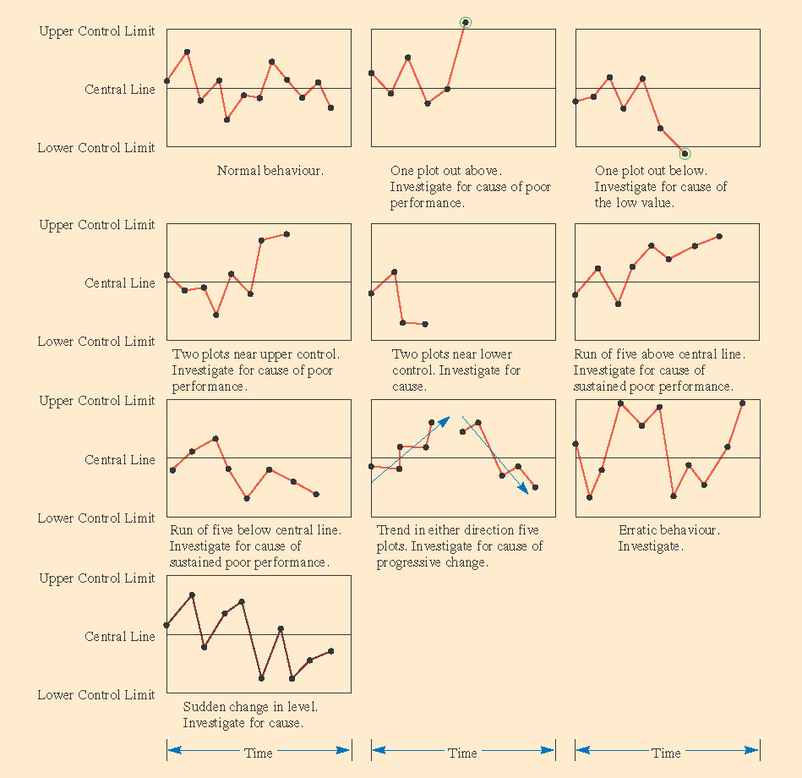
Process Control – Control Charts

Slide 27
Process Control – Control Charts

Slide 28
Statistical Process Controls
What it is NOT:
a tool to determine whether a lot of goods is within specification
This is called “acceptance sampling” and is something altogether different
What it IS:
a tool to identify when our process is behaving in an unexpected way
we use product/service measures in order to better understand the behaviour of the process that fabricated/delivered those products/services
when the process is behaving unexpectedly, as demonstrated by our control measures, this is a signal to management to intervene

Slide 29
Break Time

Slide 30
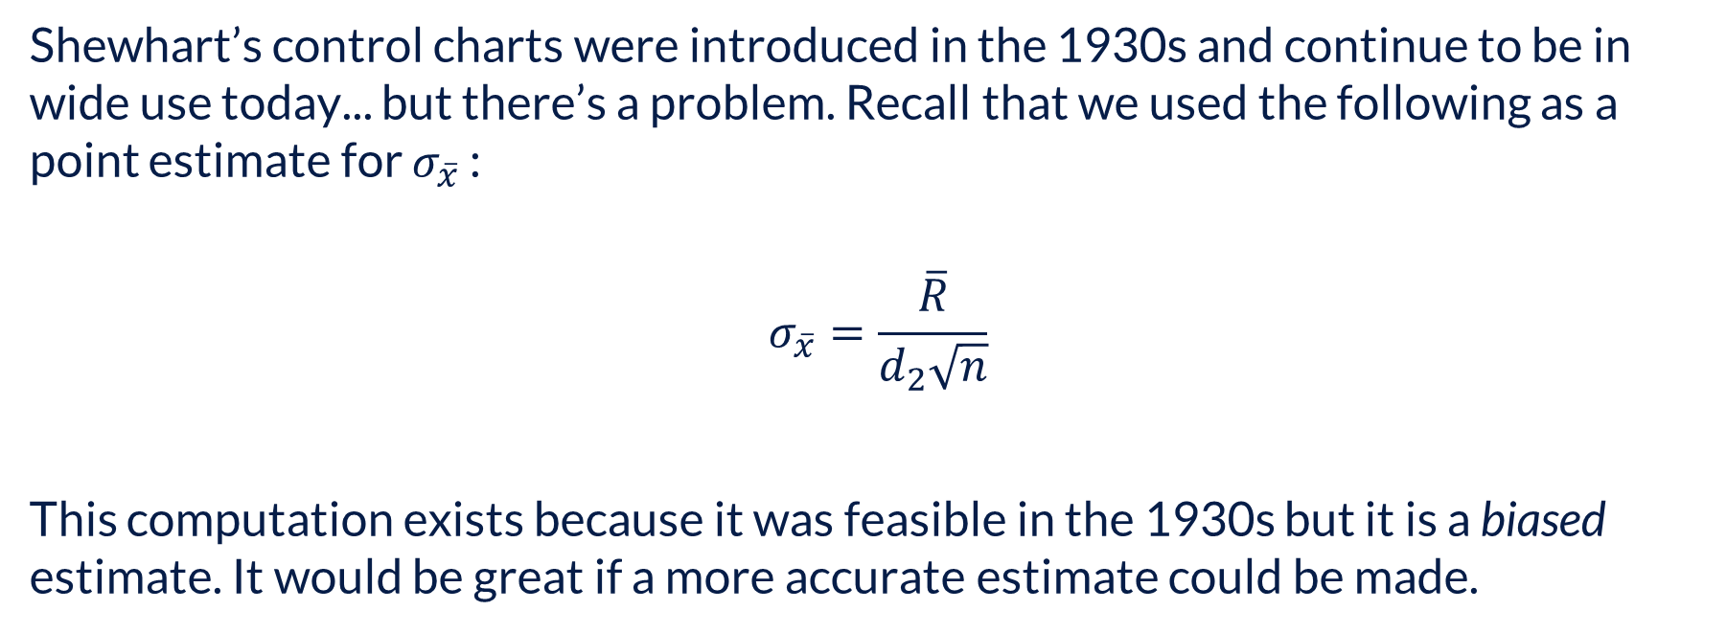
Control Charts – Unbiased or biased?
Shewhart’s control charts were introduced in the 1930s and continue to be in wide use today... but there’s a problem. Recall that we used the following as a point estimate for $σ_{\overline{x}}$ :
$$σ_{\overline{x}}=\frac{\overline{R}}{d_{2}\sqrt{n}}$$
This computation exists because it was feasible in the 1930s but it is a biased estimate. It would be great if a more accurate estimate could be made.

Slide 31


Control Charts - Unbiased
While $s^{2}$ is an unbiased estimated of $σ^{2}$, $s$ is a biased estimate of $σ$
 | Population |  | Sample Data |  |  | St Dev | Var
 | 10 |  | A | 10 | 10 | 0 | 0
 | 11 |  | B | 10 | 11 | 0.707107 | 0.5
 | 12 |  | C | 10 | 12 | 1.414214 | 2
Var | 0.666667 |  | D | 11 | 10 | 0.707107 | 0.5
St Dev | 1 |  | E | 11 | 11 | 0 | 0
 |  |  | F | 11 | 12 | 0.707107 | 0.5
 |  |  | G | 12 | 12 | 0 | 0
 |  |  | H | 12 | 10 | 1.414214 | 2
 |  |  | I | 12 | 11 | 0.707107 | 0.5
 |  |  |  |  | Average: | 0.628539 | 0.666667
Here,
$$\overline{{s_{i}}^{2}}=σ^{2}$$
But,
$$\overline{s_{i}}≠σ$$

Slide 32
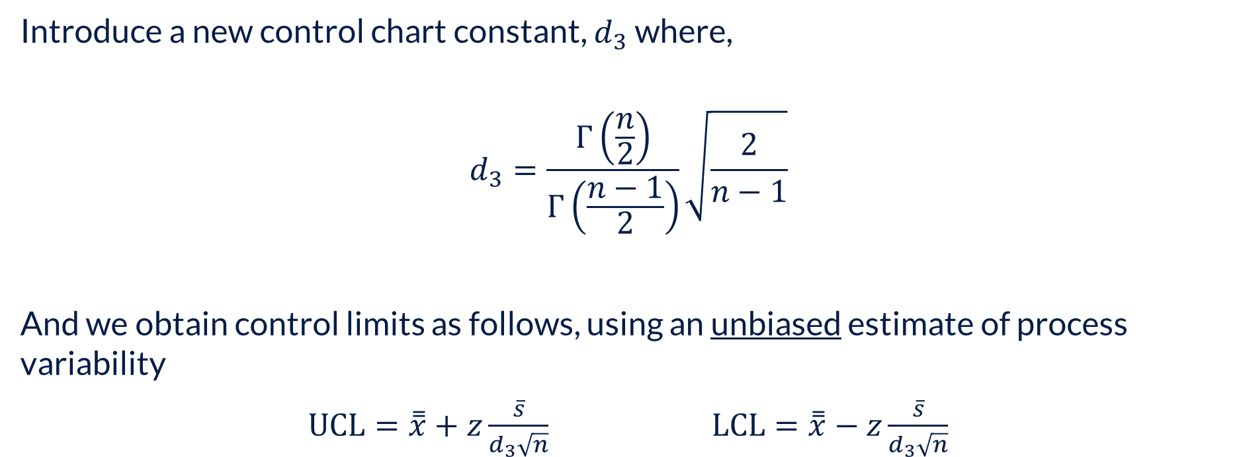

Control Charts – the $\overline{x}$-Chart obtained using $s$
Introduce a new control chart constant, $d_{3}$ where,
$$d_{3}=\frac{Γ\left(\frac{n}{2}\right)}{Γ\left(\frac{n−1}{2}\right)}\sqrt{\frac{2}{n−1}}$$
And we obtain control limits as follows, using an unbiased estimate of process variability
$\text{UCL}=\overset{̿}{x}+z\frac{\overline{s}}{d_{3}\sqrt{n}}$ $\text{L}\text{CL}=\overset{̿}{x}−z\frac{\overline{s}}{d_{3}\sqrt{n}}$

Slide 33
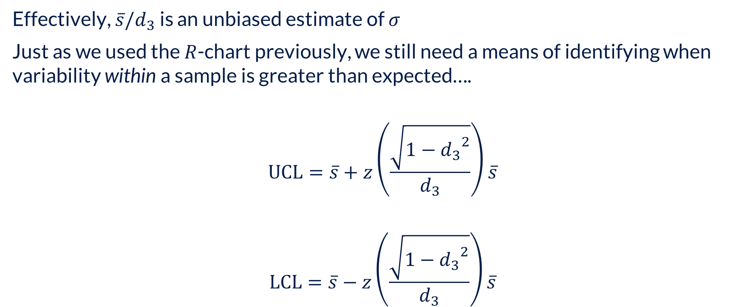

Control Charts – the $s$-Chart
Effectively, $\overline{s}/d_{3}$ is an unbiased estimate of $σ$
Just as we used the $R$-chart previously, we still need a means of identifying when variability within a sample is greater than expected….
$$\text{UCL}=\overline{s}+z\left(\frac{\sqrt{1−{d_{3}}^{2}}}{d_{3}}\right)\overline{s}$$
$$\text{LCL}=\overline{s}−z\left(\frac{\sqrt{1−{d_{3}}^{2}}}{d_{3}}\right)\overline{s}$$

Slide 34
Other Charts

Slide 35
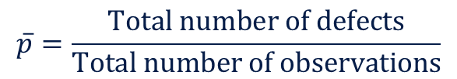

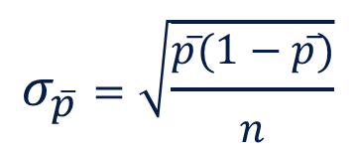

The $p$-chart
Used for measuring the proportion of defective product. More specifically, for binary response variables, e.g., did the engine start (yes/no)
$$\overline{p}=\frac{\text{Total} \text{number} \text{of} \text{defects}}{\text{Total} \text{number} \text{of} \text{observations}}$$
$$\text{UCL}=\overline{p}+{zσ}_{\overline{p}} \\ \text{LCL}=\overline{p}−{zσ}_{\overline{p}}$$
$$σ_{\overline{p}}=\sqrt{\frac{\overline{p}(1−\overline{p})}{n}}$$

Slide 36


The $c$-chart
Used for monitoring the number of defects in a single product/service.
$$\text{UCL}=\overline{c}+z\sqrt{\overline{c}}$$
$$\text{LCL}=\overline{c}−z\sqrt{\overline{c}}$$

Slide 37
Coping with Frequency Data

Slide 38
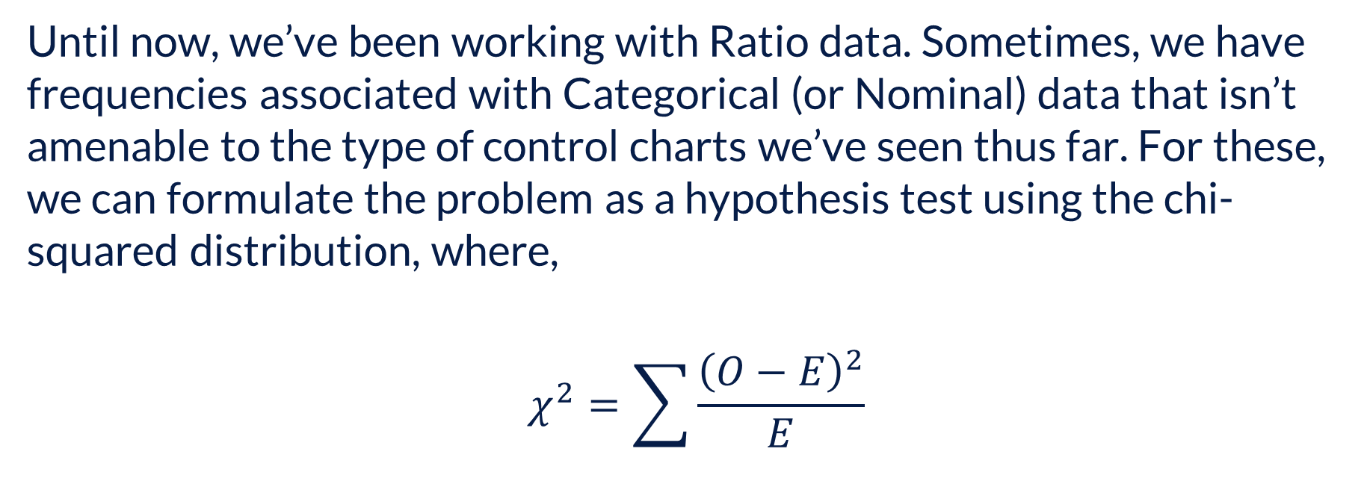
Frequency Data
Until now, we’ve been working with Ratio data. Sometimes, we have frequencies associated with Categorical (or Nominal) data that isn’t amenable to the type of control charts we’ve seen thus far. For these, we can formulate the problem as a hypothesis test using the chi-squared distribution, where,
$$χ^{2}=\sum{\frac{{\left(O−E\right)}^{2}}{E}}$$

Slide 39
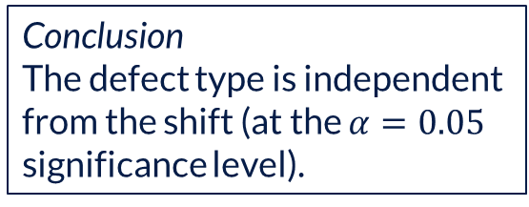
Frequency Data
Conclusion
The defect type is independent from the shift (at the $α=0.05$ significance level).

Slide 40
Closing Comments

Slide 41
Limitations
An in-control process doesn’t imply product is within tolerances or specifications
Control charts are not conclusive evidence for use in RCA
Akin to hypothesis testing,
Type I Error (α), i.e., false positive
Type II Error, i.e., false negative
There are many more forms of control charts than what I’ve presented here.

Slide 42
Case Discussion

